Slide 1
Teachers as educational developers. (Praise the teacher 3.0)
The results of three years of research into the Teachers Development FunD (LOF)

Slide 2
researchers Anja Hendriks arda droppers Robert-jan Gruijthuijzen melanie van Tuijl bart ten bosch christien Overdiep christel verberg marco snoek adrienne molenaar stefanie langenaar anita Buitelaar
Πάντα ῥεῖ

Slide 3
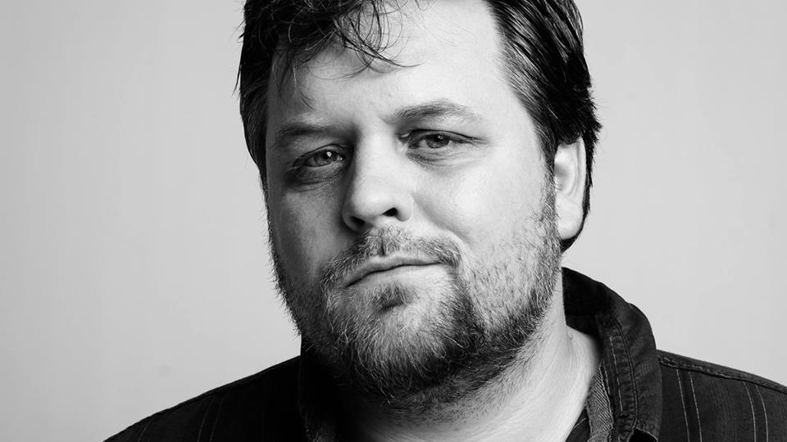
Robert-jan Gruijthuijzen
Teacher of philosophy (Udens College)
Research coordinator
Researcher LOF (Teachers Education Fund)
Trainer (Trainees in Education)
Member of the NRO programme committee “lerarenagenda 2013-2020”

Slide 4
Predecessor teachers development fund: Education pioneers (onderwijspioniers) (2007/2008) - intrinsic motivation - dijsselbloem report 2008 - less bureaucracy - smaller than LOF - Funding teachers not schools - less procedures for funding than lof - social capital - teacher as innovator

Slide 5
General facts concerning the teachers development fund
School year | Number of applications | Granted applications
2015-2016 | 554 | 184
2016-2017 | 517 | 205
2017-2018 | 521 | 161
2018-2019 | 501 | 91
The Teachers Development Fund is all for and by the teachers, where
teachers submit applications
teachers assess applications
teachers are part of the guidance process
teachers do research into the Teachers Development Fund

Slide 6
General facts concerning the teachers development fund
Reinforcing the quality of education
Facilitating teachers in realizing their initiatives
Qualitative strengthening education within their school
Initiating and promoting powerful teaching
Contributing to the emergence of learner teacher networks

Slide 7
A COMMON GROUND?
THE TEACHERS DEVELOPMENT FUND INVOLVES HUNDREDS OF TEACHERS FROM ALL OVER THE COUNTRY, FROM DIFFERENT CONTEXTS, WITH DIFFERENT EDUCATIONAL BACKGROUNDS, FROM DIFFERENT SCHOOLS, TEACHING DIFFERENT SCHOOL SUBJECTS AND FROM DIFFERENT SECTORS. WHAT THEY SHARE IS THE FACT THAT THEY ALL TEACH!

Slide 8
Three years of research: monitor (2017))8, 2019)
What is the added value of the LOF process - given the objectives - for the LOF teacher and his environment and what are the stimulating and challenging factors?

Slide 9
Three years of research: In-depth research (2018-2019)
Role of networks & network development
Sustainable implementation of LOF initiatives
How does participation as a LOF teacher contribute to the development of (innovative) networks that support the LOF teacher in realizing his LOF initiative?
Which factors influence the sustainable implementation of LOF initiatives within the school and which supporting role does the LOF play in this?

Slide 10
Three years of research: In-depth research (2018-2019)
Role of networks & network development
Sustainable implementation of LOF initiatives

Slide 11
Three years of research – three key insights
Level of initiative: classroom, school, above school
Level of education: bachelor, hbo-master, wo-master
Sector: primary school, secundary school

Slide 12
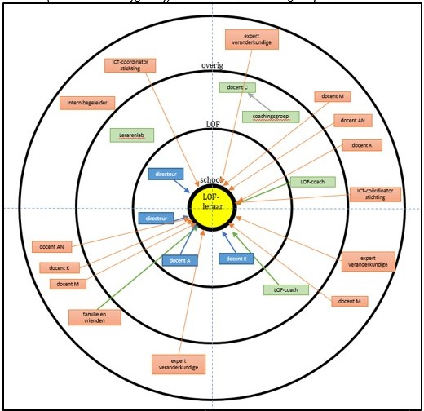
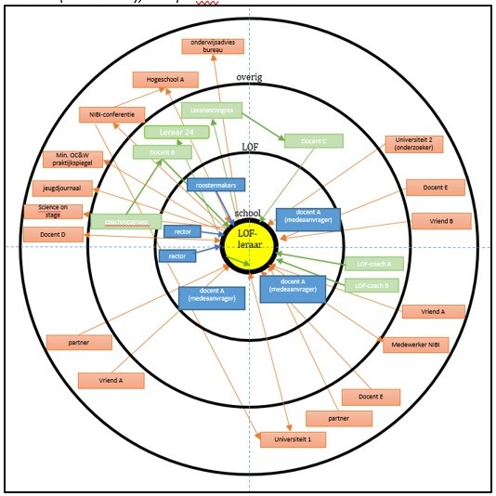
Level of initiative: classroom – school – above school how the level of the initiative affects the teachers’ networks

Slide 13
The LOF teacher and the changing position in the school at the application level
 | Classroom (n=39) |  | School (n=114) |  | Above school (n=57)
 | M | SD | M | SD | M | SD
Due to my LOF traject, colleagues are more often approaching me | 3.08 | 0,98 | 3.20* | 1.14 | 2.75* | 1.29
My LOF traject gives me the feeling that I am being taken more seriously by my colleagues within the school. | 2.69 | 1,00 | 2.83* | 1.10 | 2.33* | 1.18
Due to my LOF traject I have started working more closely with (a part of) my colleagues. | 3.21 | 1,20 | 3.60** | 1.04 | 2.89 | 1.38

Slide 14
LOF teacher as a motor for innovation culture within school boards.
 | Classroom (n=39) |  | School (n=112) |  | Above school (n=57)
 | M | SD | M | SD | M | SD
Because of my LOF traject I am aware of the impact that a teacher can have on educational innovation / educational innovation at national level. | 3.33* | 1.15 | 3.62 | 1.15 | 3.82 | 1.30
I actively look for stages / platforms (Meetups, conferences, etc.) where I can share my knowledge and skills that I have acquired during my LOF traject with other teachers. | 2.59** | 1.14 | 2.90* | 1.28 | 3.44** | 1.44
I share my knowledge and skills acquired during my LOF traject on stages / platforms (Meetups, conferences, etc.) so that other teachers can benefit from this. | 2.85 | 1.18 | 2.81* | 1.28 | 3.49* | 1.46

Slide 15
Impact of LOF on experiences of LOF teachers.
 | Classroom (n=39) |  | School (n=112) |  | Above school (n=57)
 | M | SD | M | SD | M | SD
As a teacher with a LOF initiative, I sometimes feel lonely at school. | 2.64* | 1.37 | 2.11* | 1.17 | 2.53* | 1.30
Working on my LOF initiative combined with being a teacher is sometimes stressful. | 3.10* | 1.17 | 2.61* | 1.14 | 2.75 | 1.14

Slide 16
Level of initiative: classroom – school – above school how the level of the initiative affects (networks of) teachers
 | Findings
Classroom | Collaboration based on school subject More (diversity of) contacts More stress and feelings of loneliness in school
School | Community building in school Easier approachable by colleagues More in-school collaboration Develop a different position in school Possible less new impulses and new perspectives Focus on implementation in school
Above school | Sharing knowledge via networks and platforms Searches more actively for contacts and networks outside the school. More awareness regarding the impact of the teacher on education development and school development More feelings of loneliness in school
 | Inwards | Outwards
Class |  | X
School | X
Above school |  | X

Slide 17
Level of education: The influence of the level of education on the development of teachers and on the support they need during the development of their initiative.
HBO bachelor
HBO master
WO master

Slide 18
Motivation for participation broken down by level of education.
 | HBO-B (n=69) |  | HBO-M (n=63) |  | WO-M (n=63)
 | M | SD | M | SD | M | SD
I participate / participated as a LOF teacher to work on my personal development. | 3.65** | 1.03 | 3.87** | 1.02 | 2.90** | 1.27
I participate / participated as a LOF teacher because I have more challenges besides being a teacher. | 3.93 | 1.09 | 4.13* | 1.20 | 3.60* | 1.28

Slide 19
Motivation for participation broken down by level of education.
 | HBO-B (n=69) |  | HBO-M (n=63) |  | WO-M (n=63)
 | M | SD | M | SD | M | SD
At school I am given the opportunity to share my knowledge within the school. | 4,47* | 0,88 | 4,05 | 1,05 | 3,95** | 1,04
At school I am given the opportunity to share my knowledge with people outside the school. | 4,38 | 0,94 | 4,03 | 1,11 | 3,90* | 1,12
I am aware of the expertise of colleagues and know what knowledge I can get where. | 4,31 | 0,74 | 4,21 | 0,77 | 3,76** | 1,03
My supervisor encourages knowledge sharing within the school. | 4,16 | 1,19 | 4,08 | 1,04 | 3,62* | 1,21
My supervisor is able to put me in contact with people who have the right knowledge to help me further. | 3,50 | 1,22 | 3,44 | 1,48 | 2,95* | 1,29
Colleagues within the school make use of the knowledge and skills that I have developed during my LOF traject. | 3,84 | 0,95 | 3,74 | 1,07 | 3,52 | 1,25
Colleagues within the school are curious and show an interest in my LOF initiative. | 3,78 | 0,94 | 3,77 | 1,09 | 3,48 | 1,09
Colleagues within the school have knowledge and skills to realize my LOF initiative. | 3,63 | 1,13 | 3,54 | 1,02 | 3,24 | 1,23
I have faith in the knowledge that is shared in the school. | 4,13** | 0,91 | 3,59 | 1,02 | 3,48*** | 1,09
The knowledge that is present at school is accessible to me. | 4,25 | 0,88 | 4,21 | 0,80 | 3,62*** | 1,08

Slide 20
Motivation for participation broken down by level of education.
 | HBO-B (n=69) |  | HBO-M (n=63) |  | WO-M (n=63)
 | M | SD | M | SD | M | SD
At school I am given the opportunity to share my knowledge within the school. | 4,47* | 0,88 | 4,05 | 1,05 | 3,95** | 1,04
At school I am given the opportunity to share my knowledge with people outside the school. | 4,38 | 0,94 | 4,03 | 1,11 | 3,90* | 1,12
I am aware of the expertise of colleagues and know what knowledge I can get where. | 4,31 | 0,74 | 4,21 | 0,77 | 3,76** | 1,03
My supervisor encourages knowledge sharing within the school. | 4,16 | 1,19 | 4,08 | 1,04 | 3,62* | 1,21
My supervisor is able to put me in contact with people who have the right knowledge to help me further. | 3,50 | 1,22 | 3,44 | 1,48 | 2,95* | 1,29
Colleagues within the school make use of the knowledge and skills that I have developed during my LOF traject. | 3,84 | 0,95 | 3,74 | 1,07 | 3,52 | 1,25
Colleagues within the school are curious and show an interest in my LOF initiative. | 3,78 | 0,94 | 3,77 | 1,09 | 3,48 | 1,09
Colleagues within the school have knowledge and skills to realize my LOF initiative. | 3,63 | 1,13 | 3,54 | 1,02 | 3,24 | 1,23
I have faith in the knowledge that is shared in the school. | 4,13** | 0,91 | 3,59 | 1,02 | 3,48*** | 1,09
The knowledge that is present at school is accessible to me. | 4,25 | 0,88 | 4,21 | 0,80 | 3,62*** | 1,08

Slide 21
Conditions with regard to networks other than the LOF network and other school-related networks.
 | HBO-B (n=32) |  | HBO-M (n=39) |  | WO-M (n=42)
 | M | SD | M | SD | M | SD
I share my LOF-related knowledge with people outside my school and my coaching group. | 3.88 | 0.91 | 4.31** | 0.86 | 3.95 | 1.13

Slide 22
Role of the school leader during the LOF process
 | HBO-B (n=69) |  | HBO-M (n=62) |  | WO-M (n=63)
 | M | SD | M | SD | M | SD
My school leader contributes / has contributed to creating support for my LOF initiative within the team. | 3.62** | 1.15 | 3.55** | 1.33 | 2.84** | 1.39
My school leader supervises / guided me in the realization of my LOF initiative. | 3.35** | 1.27 | 2.85 | 1.34 | 2.46** | 1.22
My school leader had / has insight into my skills acquired during the LOF process. | 3.29* | 1.15 | 3.21* | 1.24 | 2.67* | 1.18
My school leader recognizes / acknowledges my skills acquired during the LOF. | 3.62** | 1.04 | 3.58** | 1.21 | 2.94** | 1.24
My school leader contributes / has contributed to the dissemination of my LOF initiative within the school. | 3.52* | 1.17 | 3.35 | 1.39 | 2.86* | 1.31
My school leader contributes / has contributed to the dissemination of my LOF initiative outside the school and outside the schoolmanagement. | 3.22** | 1.25 | 3.13** | 1.44 | 2.41** | 1.29

Slide 23
Level of education: The influence of the level of education on the development of teachers and on the support they need during the development of their initiative.
All teachers use the LOF to develop education
Teachers focus less, in comparison to other qualities concerning teacher leadership, on building (ego) networks
HBO bachelors and masters consider LOF to a greater extent as a form of professionalization focused on the development of insight into change processes, self-confidence, one's own vision on education and the support and stimulation of others
HBO bachelors and masters value collaborating with, and sharing on, developments with colleagues from other sectors and from other professional disciplines and managers more
WO masters indicate that the school manager played less of a role during the realization of their initiative
WO masters are more focused on the realization of their initiative
WO masters prefer collaborating with subject specific colleagues

Slide 24
LOF teacher as a motor for an innovation culture within the school board
 | Primary (n=80) |  | Secundary (n=109)
 | M | SD | M | SD
Through my LOF traject I am aware of the impact that I can have as a teacher on the innovation culture within the school board. | 3.95** | 1.03 | 3.52 | 1.14
My knowledge and skills acquired during the LOF process are known within the school board. | 3.25** | 1.16 | 2.50 | 1.25
I am actively looking for ways in which I can spread my knowledge and skills acquired during the LOF process within my school (and other locations). | 3.64** | 1.15 | 2.96 | 1.25
Through my LOF traject I encourage teachers to work on educational innovation / educational development. | 3.71** | 1.13 | 3.02 | 1.19
Through my LOF traject I spread the vision in which the teacher is the driving force behind education innovation / education development among teachers. | 3.70** | 1.14 | 3.00 | 1.25
Teachers in my school approach me for advice because of my LOF initiative. | 3.09** | 1.33 | 2.56 | 1.31

Slide 25
Sector: Primary or secundary education The influence of education sector on the development of teachers and on the support they need during the development of their initiative.
Primary education teachers see themselves on all statements more as a motor for innovation culture in the school

Slide 26
Three years of research – three key insights
Level of initiative: classroom, school, above school
Level of education: bacher, hbo-master, wo-master
Sector: primary school, secundary school
Implementation concerns collaboration in a school community
Innovation concerns collaboration in diverse networks
Implementation in a school community does not automatically lead to innovation
Innovation does not automatically lead to implementation in a school community
Innovation can be stressful and lonely
Clear difference between primary and secondary school teachers
Clear difference based on educational background

Slide 27
So? How to deal with the duality/tension between implementation and innovation, ergo: between the community and the innovative network?
The results of three years of research into the Teachers Development FunD

Slide 28
The end
Thank you for listening!
Any questions? Robert-Jan Gruijthuijzen
E-mail: lof.onderzoek@caop.nl or gruijthuijzen@hotmail.com
Linkedin: https://www.linkedin.com/in/gruijthuijzen/ Website: http://filosofie.gruijthuijzen.nl
Visit the Teachers Development Fund for more information @https://www.lerarenontwikkelfonds.nl/

